Slide 1
Project NBA
Team Members: Jasmeet Bajwa, Jordon Nesbitt, Criselda Dimacali, Inna Gurevitch

Slide 2
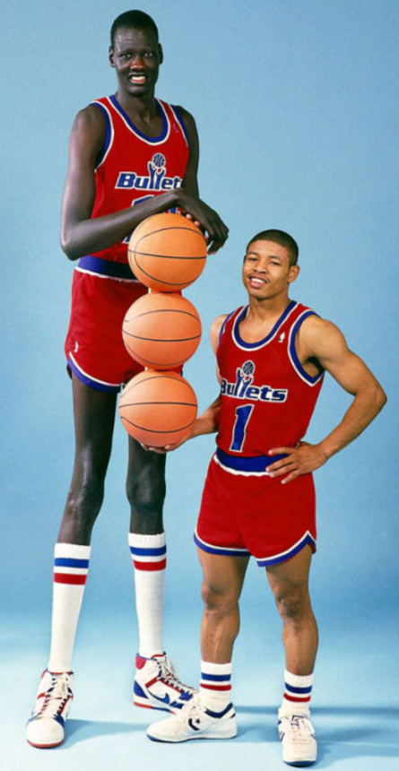

Motivation & Questoins
Speaker 1:Criselda Dimacali
What characteristics make the ultimate NBA Player??
weight
age
Years_played
Team_rank
Is it their height & weight? or is it their age that contributes to their success?
Notes:
Hi Everyone, good morning and thank you being here. We are here to present our data analysis for our Project NBA…. Project NBA all started with our motivated question… “ What are the characteristics that makes the ultimate NBA player? …Is it their height & weight? or is it their age that contributes to their success?...
And from there we have made our hypothesis that weight, height, age, Years played and team rank have got to be the major contributor in the making of the ultimate NBA player.
The purpose of this exploration is to present statistical evidence of correlation between variables that we commonly see in NBA player statistics, like points and free throws. It is a great topic of debate that can last very long for basketball enthusiasts.
We decided to take a leap and study multiple data from the top two links found in Google…..which are KAGGLE and SPORT REFERENCE as our sources. This gave us our independent variables from our hypothesis and 46 dependent variables.
With full confidence, we decided to find out the answers to our questions, given we have a strong team that consists of a chemical engineer, a project manager, a business developer and an industrial engineer.
We research the best approach in creating statistical model to validate the relationships of each of the variables. It also created a mixture of exciting and frustrating moments. From coming up with the questions we want to solve to narrowing down the scope. It made the final results more gratifying specially when we proved our assumption that height, weight and age have correlation in the making of the ultimate NBA player.

Slide 3
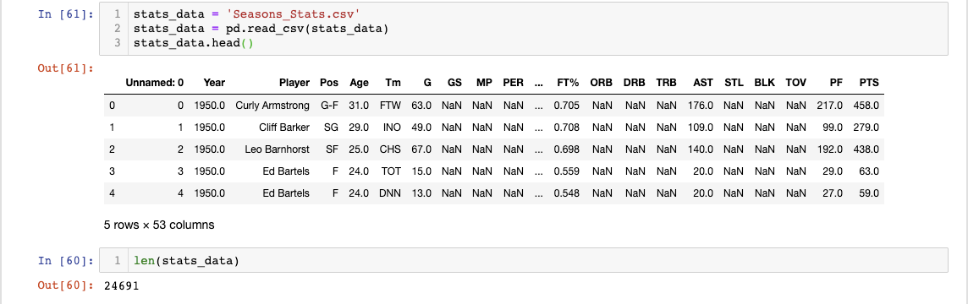
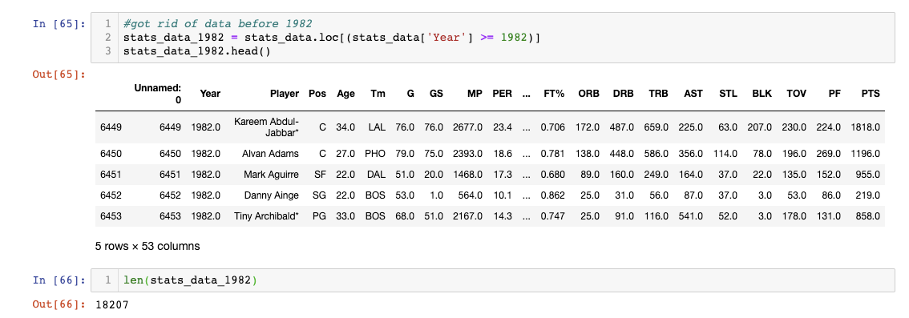
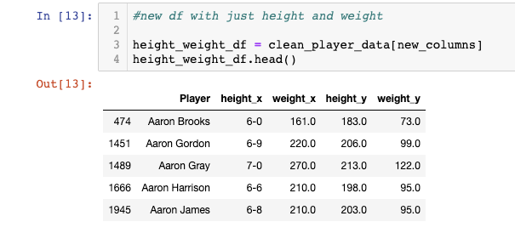
Data Cleanup & Exploration Speaker 2: Jasmeet Bajwa
Data Cleanup:
Commonly used functions/methods: pd.merge(), drop duplicates(), .rename() and isna,drop.na/fill.na/drop zeros (!=0 used)
Multiple columns for height and weight
Missing data for players before 1982
Notes:
Commonly used functions/methods: merge, drop duplicates, .rename() and drop.na/fill.na/drop zeros (0)
Merged stats data with player data and grouped.by
The data exploration and cleanup process (accompanied by your Jupyter Notebook) Describe the exploration and cleanup process.
merge -> drop duplicates -> drop.na
Quick analysis of data (what do we need?)
There were a lot of empty columns, zeros or N/As
A lot of missing data for time before 1982

Slide 4
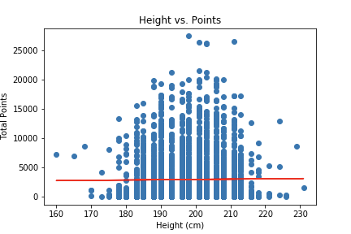
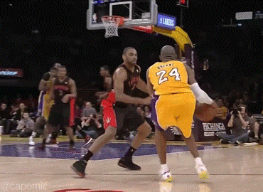
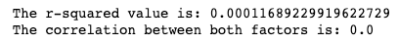
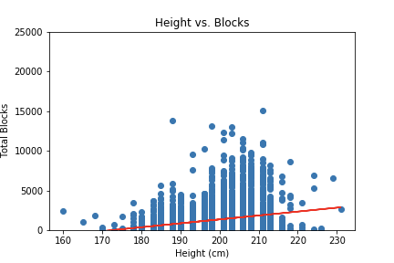
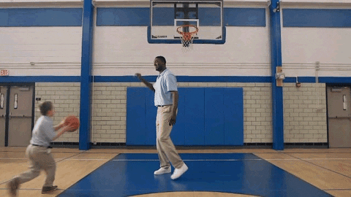
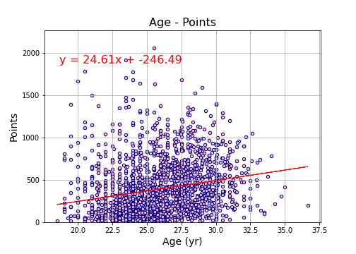
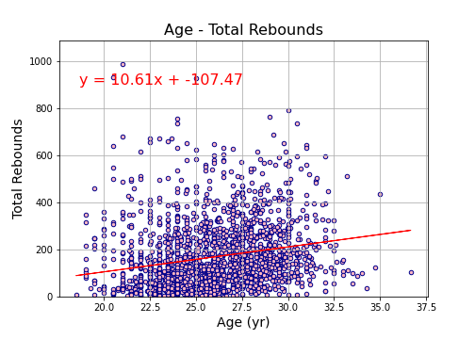
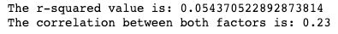
Data Cleanup & Exploration Speaker 2: Jasmeet Bajwa
Data Exploration:
What is the best way to merge, groupby/filter by what? Least amount of bias
No correlation! Correlation? A lot of data to go through to find relevant variables
Variance
Too much data!
Notes:
Exploration: We had three different data sets
Discuss insights you had while exploring the data that you didn't anticipate
Discuss any problems that arose after exploring the data, and how you resolved them
Present and discuss interesting figures developed during exploration, ideally with the help of Jupyter Notebook
how long has the nba been around for?
years played and turnovers before refs?
For age there is a large variance in our data

Slide 5
Data Analysis Speaker 3: Inna Gurevitch
The analysis process :
Mapping of correlating variables among all dependant vs. independant variables (performance characteristics, as points, assist / block percentage, turnovers, shooting %, etc)
Breaking down into smaller sets
Choosing only strong correlations among all players (-0.3 < r^2 > 0.3)
Scatter plots of strong correlations, and calculating linear regressions, p_values.
Used merge, groupby methods from Pandas; Linear regression from Matplotlib, skystats, seaborn
Notes:
Technology used

Slide 6
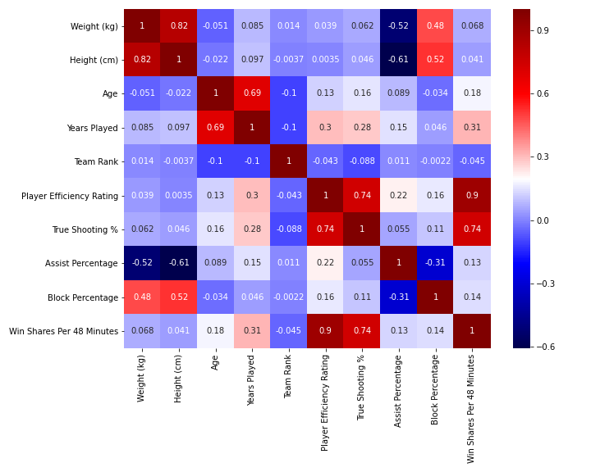
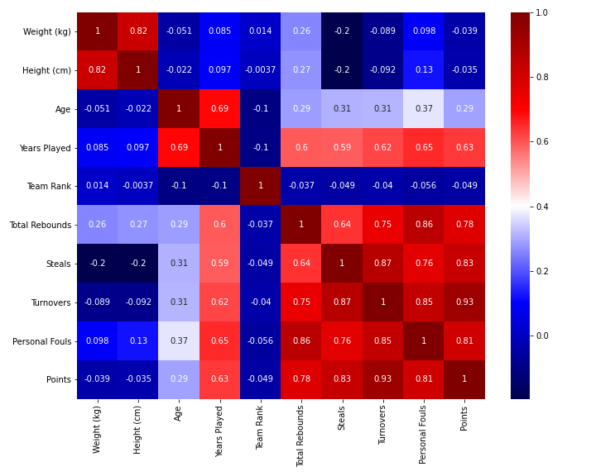
Correlations Mapping
Data Discussion Speaker 3: Inna Gurevitch
Dependent variables, Set1:
# Player Efficiency Rating'
# True Shooting %'
# 'Assist Percentage'
# Block Percentage'
# 'Win Shares Per 48 Minutes'
Dependent variables, Set2:
# Free Throw Rate
# Total Rebound Percentage
# Steal Percentage
# Turnover Percentage
# Usage Percentage
Dependent variables, Set3:
# Win Shares
# Field Goal Percentage
# 2-Point Field Goal Percentage
# 3-Point Field Goal Percentage
# Effective Field Goal Percentage
# Free Throw Percentage
Dependent variables, Set4:
# Total Rebounds
# Steals
# Turnovers
# Personal Fouls
# Points
Notes:
Technology used

Slide 7
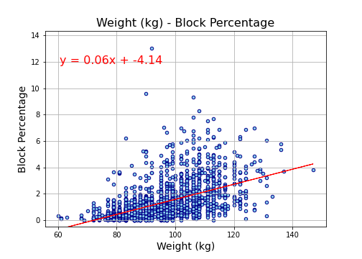
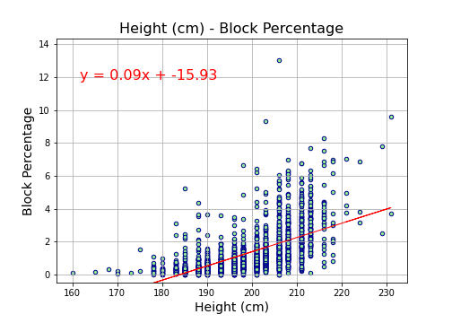
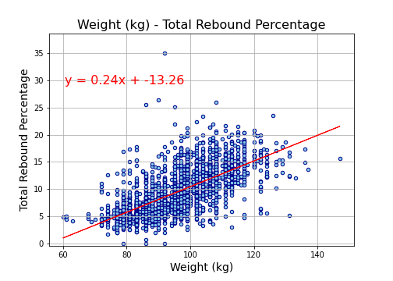
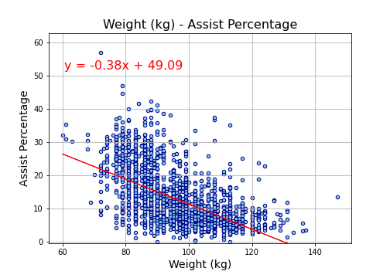
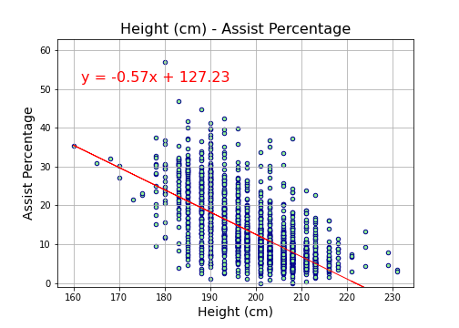
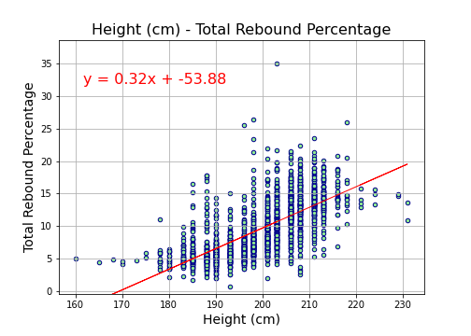
Data Discussion Speaker 3: Inna Gurevitch
Found Correlations: Players Weight & Height
Increase in Block Percentage with height and weight (positive correlation)
Decrease in Assist Percentage with height and weight (negative correlation)
Increase in Total Rebounds with height and weight (positive)
Notes:
Technology used

Slide 8
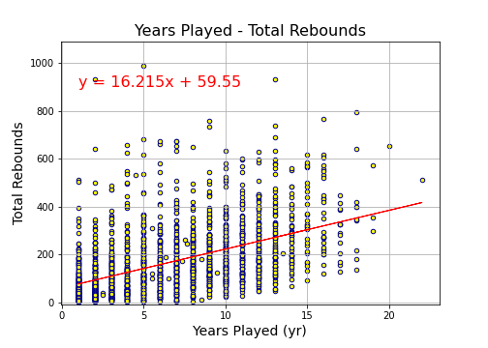
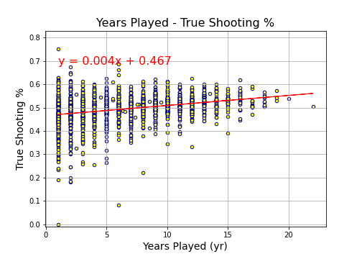
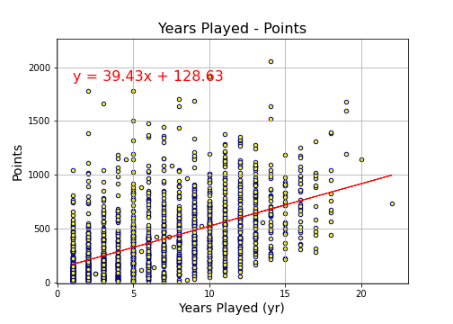
Found Correlations: Years Played
Data Discussion Speaker 3: Inna Gurevitch
Increase in Total rebounds with years_played (positive correlation)
Increase in Points with years_played (positive)
Increase in True Shooting % with years_played (positive) (PTS / (2 * TSA))
Notes:
Technology used PTS / (2 * TSA). --.> true shooting attempts

Slide 9
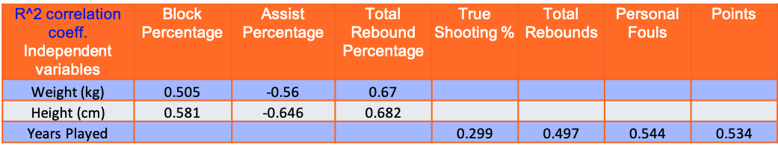
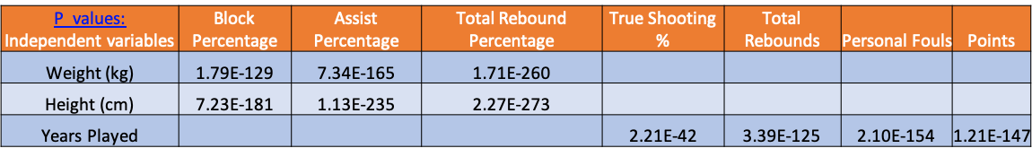
Conclusion Speaker 4: Jordon
Your conclusions, which should include a numerical summary and visualizations of that summary
Discuss your findings.
Did you find what you expected to find? If not, why not?
What inferences or general conclusions can you draw from your analysis?
The implications of your findings: what do your findings mean?

Slide 10
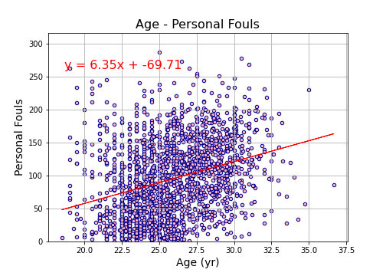
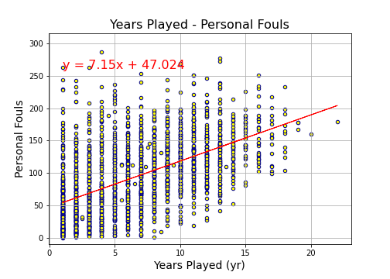
Post Mortem
Speaker 4: Jordan
Discuss any difficulties that arose, and how you dealt with them
Discuss any additional questions that came up, but which you didn't have time to answer: What would you research next, if you had two more weeks?
years played vs. personal fouls

Slide 11

Questions

